Slide 1
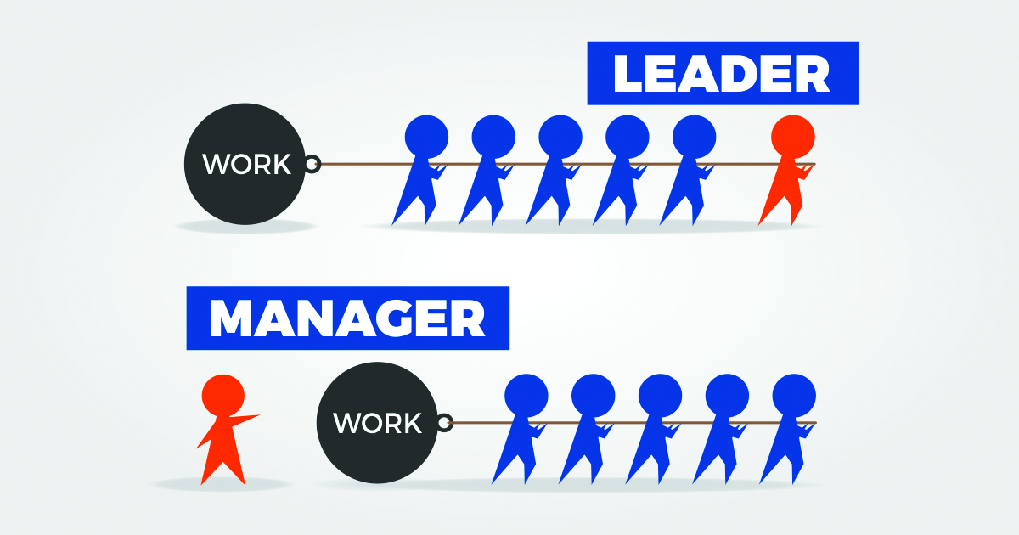
Sociology
Sajid Khan

Slide 2
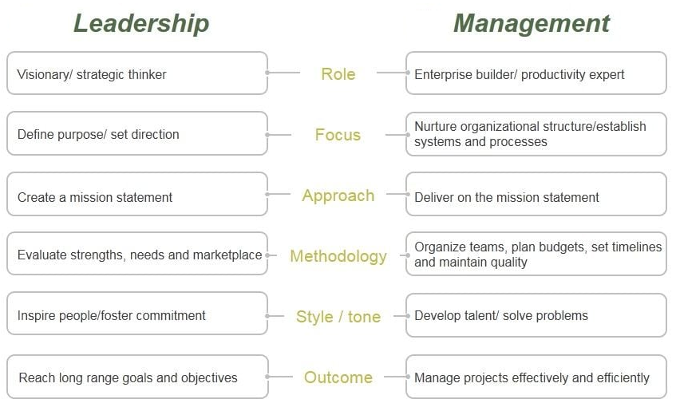
Leadership Vs. Management
Leadership involves the ability to inspire, influence, and guide individuals, teams, or entire organizations toward achieving a shared vision or goal. In contrast, management refers to the structured process of planning, organizing, and overseeing tasks to ensure that organizational objectives are met efficiently and effectively. While leadership focuses on vision and motivation, management emphasizes execution and operational precision.

Slide 3
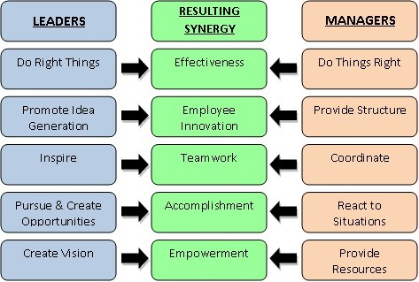
Leadership and Management
Management provides stability and employs a rational approach to consistently execute complex routines within a unidirectional authority structure. In contrast, leadership fosters multidirectional influence by inspiring, innovating, and stimulating workforce commitment while aligning efforts with the right direction. When management and leadership work together, they create synergy, driving organizations toward success.

Slide 4
Leadership Role
Having a Vision: A leader sets a clear and compelling direction for the organization, defining its purpose and long-term goals. This vision serves as a guiding light for all stakeholders.
Developing Strategy: Leaders translate the vision into actionable plans by formulating strategies that outline the steps and resources required to achieve organizational objectives.
Communicating Effectively: Effective leaders ensure their vision and strategy are understood by all members of the organization. They foster open dialogue, listen actively, and adapt their communication style to suit different audiences.
Creating the Culture for the Organization: Leaders shape and nurture a positive organizational culture by promoting shared values, fostering collaboration, and setting an example through their behavior.
Managing and Monitoring Performance: Leaders ensure accountability by establishing performance metrics, monitoring progress, and providing feedback to keep the team aligned with the organization's goals.

Slide 5
Attributes of Leader
Strategic Thinker: The ability to analyze complex situations, anticipate future trends, and create long-term plans for success. It involves focusing on the bigger picture while balancing short-term needs.
Strategic Learner: A mindset focused on continuous improvement, adaptability, and learning from diverse experiences. Strategic learners actively seek knowledge to align with their goals.
Empathetic: The capacity to understand and share others' feelings, building stronger connections and fostering trust.
Emotional intelligence: The ability to recognize, understand, and manage one's emotions while effectively navigating relationships. It comprises several components:
Self-awareness: Understanding your own emotions, strengths, weaknesses, and values, and how they impact others.
Self-management: Regulating emotions, staying calm under pressure, and adapting to changing circumstances.
Social awareness: Being attuned to others' emotions, needs, and concerns. It includes empathy and organizational awareness.
Social skills: Building and maintaining relationships, communicating effectively, and resolving conflicts constructively.

Slide 6
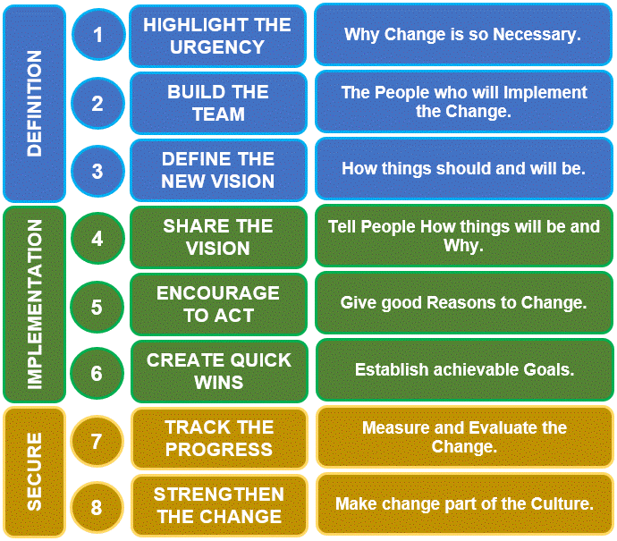
Kotter's 8 Step Change Model

Slide 7
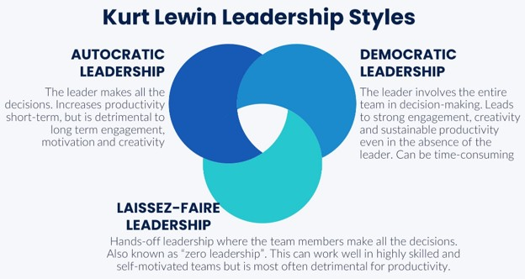
Leadership Style

Slide 8
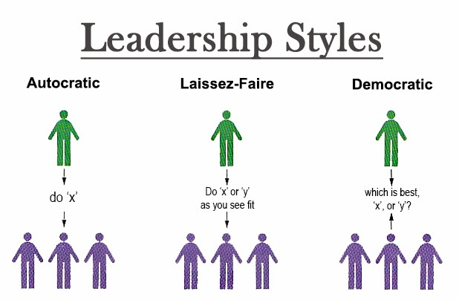

Slide 9
Leadership Style
Authoritarian Leadership: It is a form of leadership style where the leader exercises strong, centralized control over decisions and expects strict compliance from subordinates. In this approach, the leader sets clear expectations, makes decisions independently, and provides minimal input or feedback from team members.
Advantages:
Efficient in crisis situations
Can be effective with unskilled or unmotivated workers
Disadvantages:
Low morale and job satisfaction
High employee turnover
Can stifle creativity and innovation
Potential for resentment and rebellion
Democratic Leadership: also known as participative leadership, is a leadership style where the leader involves team members in decision-making, encourages collaboration, and values their input while still maintaining final authority over decisions.

Slide 10
Leadership Style
Advantages:
High employee morale and job satisfaction
Increased creativity and innovation
Improved problem-solving
Stronger team cohesion
Disadvantages:
Slower decision-making process
Can be less effective in crisis situations
Requires strong leadership skills to guide the group
Laissez-Faire Leadership: also known as delegative leadership, is a hands-off leadership style where leaders provide minimal guidance to their team, granting them the autonomy to make decisions and manage their tasks independently.
Advantages:
Can be effective with highly skilled and motivated employees
Encourages self-direction and creativity
Reduces micromanagement

Slide 11
Leadership Style
Disadvantages:
Can lead to a lack of direction and focus
May result in poor performance and low productivity
Requires strong self-discipline and accountability from employees
The best leadership style depends on the situation. Complex tasks often benefit from a collaborative approach, while simpler tasks might need a more directive style. Skilled teams can work independently, while less experienced teams need more guidance. In crises, strong leadership is crucial, while long-term projects benefit from a more participatory approach. By understanding these factors, leaders can choose the most effective style for each situation.

Slide 12
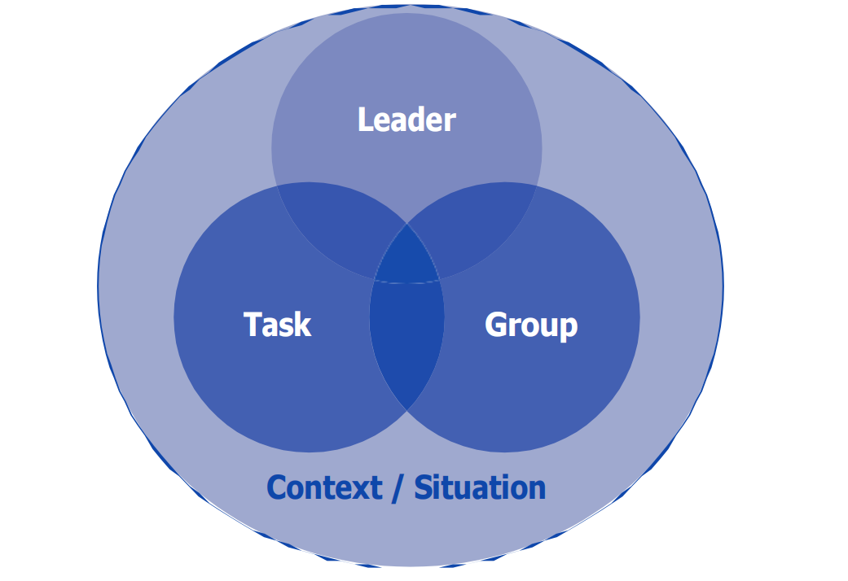
Contingency Theory in Leadership
Contingency Theory asserts that there is no universally "best" leadership style. Instead, effective leadership depends on the dynamic interaction between the leader, the group, the task, and the broader context. Leadership styles are broadly categorized as task-oriented (focused on goal achievement) or relationship-oriented (focused on building interpersonal connections). To achieve optimal results, leaders must either adapt their style to the situation or work to influence the situation to align with their strengths.

Slide 13
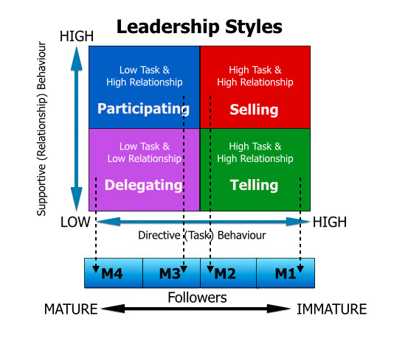
Leadership, Task and Employee
The appropriate leadership style can vary from one department, unit, or division to another. It may change within a department based on specific situations a leader encounters.

Slide 14
Situational leadership
This model identifies four distinct leadership styles, each tailored to different situations and employee needs:
Delegating: The manager assigns responsibility for a task to employees, maintaining a hands-off approach while staying informed about progress.
Participating: The manager collaborates with employees, sharing ideas and jointly planning the way forward. This approach emphasizes teamwork and mutual decision-making.
Telling: The manager gives explicit instructions on how tasks are to be completed, with no input from employees.
Selling: The manager provides clear directives on how tasks should be executed but takes the time to explain the rationale behind their decisions, ensuring employee buy-in.
Employees vary in their ability and willingness to perform tasks. A Situational Leader must assess each employee’s capability and readiness (maturity) and adapt their leadership style accordingly. By aligning their approach with the employee's level of ability and willingness, leaders can maximize productivity and effectiveness.

Slide 15
Leadership and Group
Leaders may adopt different styles based on the group they lead. The level of autonomy in decision-making and the leader's authority influence the chosen leadership style.

Slide 16
Leadership and Situation
Must not be autocratic/ dictitorial leader.
Must be able to use informal influence.
Must be able to handle conflict.
Must have mediation and negotiation skills
Mediation refers to a in which a neutral third party, called a mediator, helps two or more parties resolve a conflict. The mediator facilitates communication and negotiation but does not impose a solution. Mediation is a voluntary process that focuses on collaboration and open communication. The mediator remains impartial and does not make decisions for the parties.
Negotiation refers to a direct communication process where two or more parties discuss their differences and work toward an agreement without involving a third party. It is carried out to find a mutually beneficial solution or compromise. Negotiation may involve bargaining, persuasion, and compromise.

Slide 17
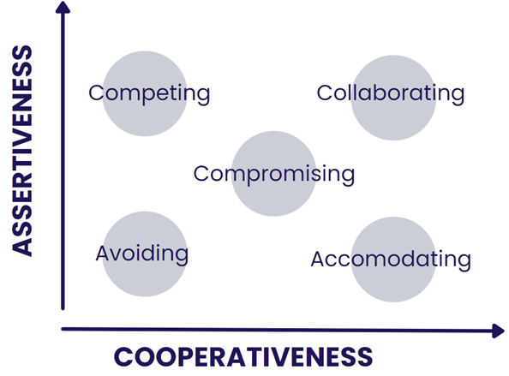
Thomas-Kilmann Conflict Model
The Thomas-Kilmann Conflict Model categorizes how people respond to conflict. It suggests that individuals can be assertive (pushing for their own needs) or cooperative (considering others' needs).

Slide 18
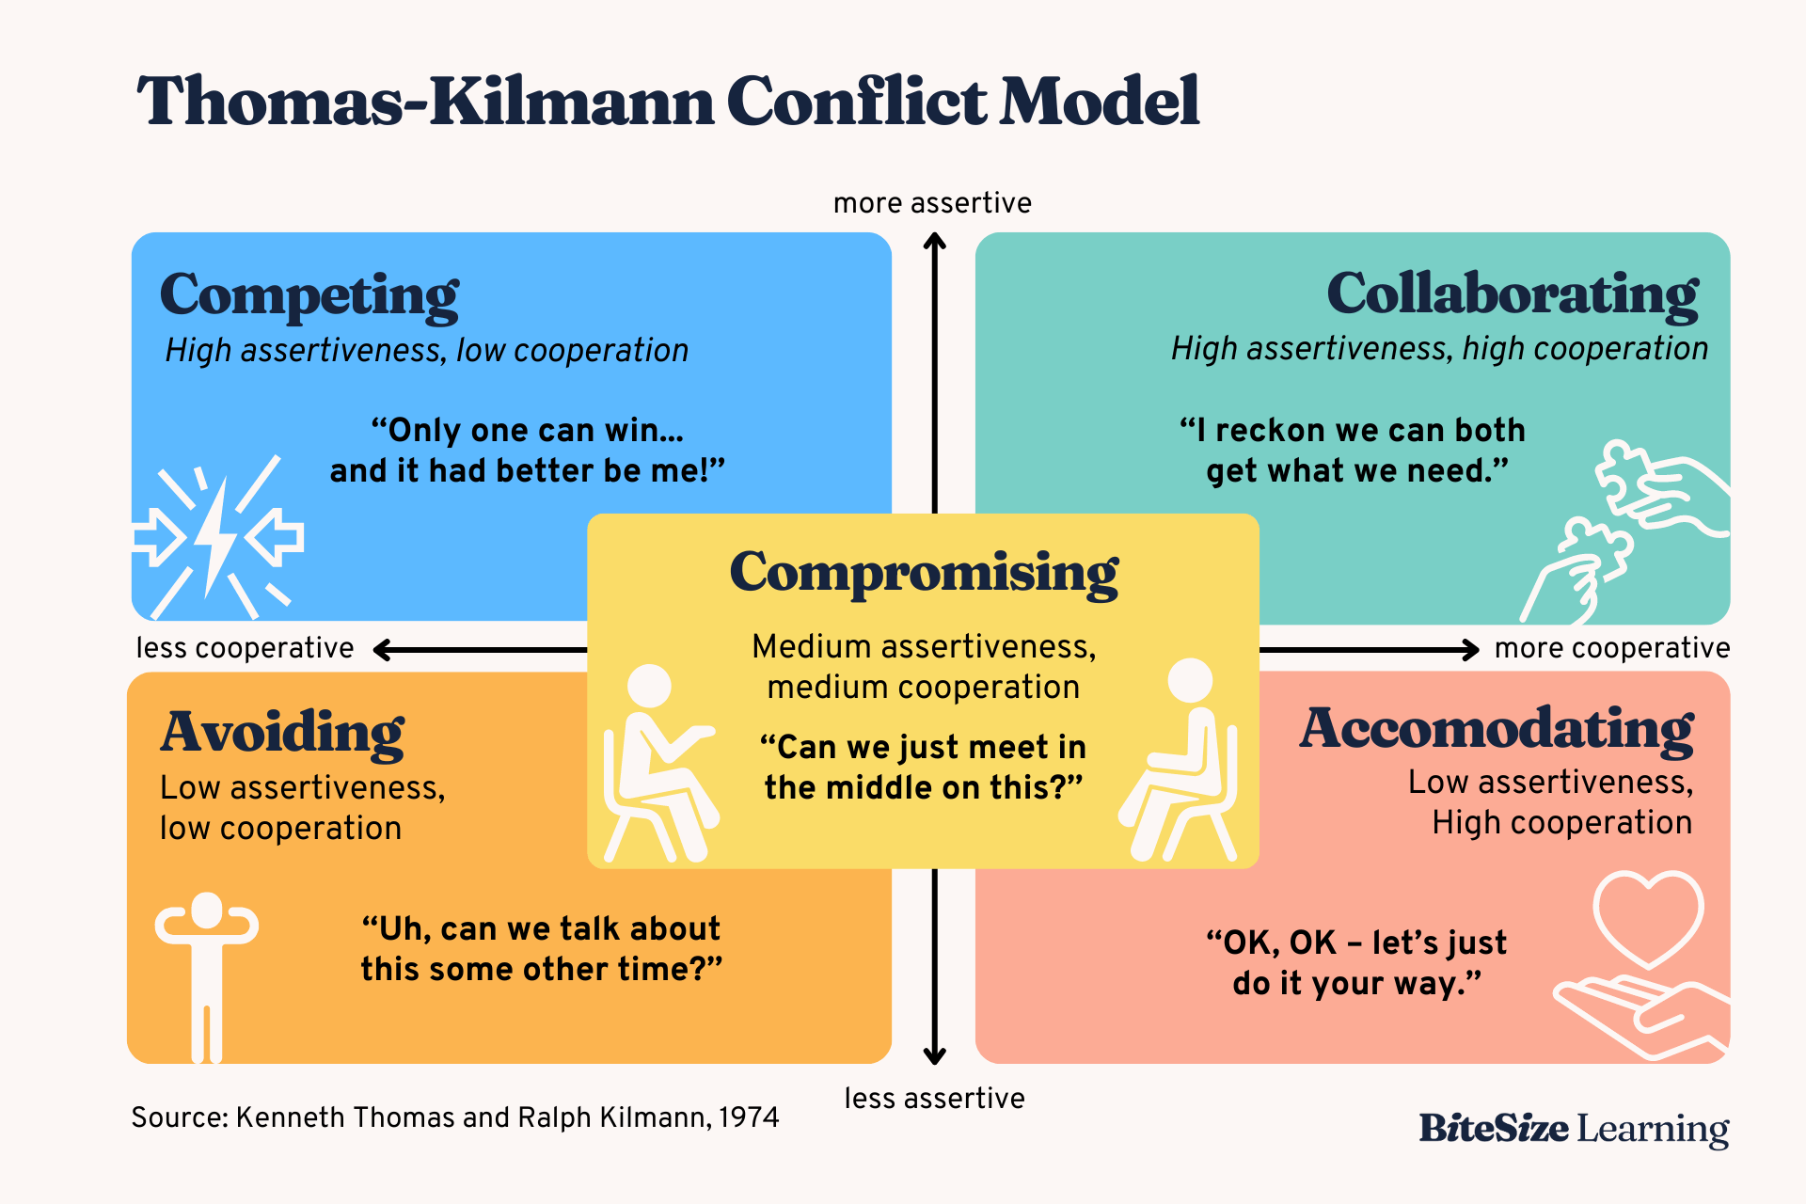

Slide 19
Thomas-Kilmann Conflict Model
The five primary conflict-handling modes are:
Competing: Assertive and uncooperative.
Accommodating: Cooperative and unassertive.
Avoiding: Unassertive and uncooperative.
Collaborating: Assertive and cooperative.
Compromising: Moderately assertive and cooperative.
The Thomas-Kilmann Conflict Mode Instrument (TKI) helps individuals assess their typical response to conflict. However, it's important to remember that people can adapt their behavior to different situations.
Understanding this model helps HR professionals, leaders, and managers to better handle conflicts and interpret the behaviors of their team members. By recognizing the strengths and weaknesses of each approach, individuals can choose the most appropriate response for a given situation.

Slide 20
Conformity
Conformity is the act of adjusting one's behavior, beliefs, or opinions to match those of a group or society. It's a common human tendency to fit in and avoid social rejection.
Why do we conform?
Normative Influence: The desire to be liked and accepted by others.
Informational Influence: The belief that others may have more accurate information.
Types of Conformity
Compliance: Publicly conforming but privately disagreeing.
Identification: Conforming to fit into a specific role or group.
Internalization: Genuinely believing and accepting the group's beliefs.
Conformity assists us in Maintaining harmony and reducing conflicts. It also Facilitates teamwork and collaboration. However, when taking to extreme, it may stifle creativity and independent thinking. Also, it can to poor decision-making.

Slide 21
Deviance: Stepping Outside the Lines
Deviance is any behavior that goes against societal norms, expectations, or rules. It's a broad concept that can encompass everything from minor infractions to serious crimes.
Why Do We Deviate?
Social Factors: Upbringing, peer pressure, and cultural norms can influence deviant behavior.
Psychological Factors: Mental health conditions can contribute to deviant behavior.
Economic Factors: Poverty and inequality can drive individuals to engage in deviant acts.
Types of Deviance
Informal Deviance: Breaking unwritten social rules. For example, burping loudly in public, talking too loudly in a library, or dressing inappropriately for a formal event.
Formal Deviance: Breaking written laws. For examples, robbery, murder, assault, and drug use.
It is important to note that deviant can vary across cultures, time periods, and social situations.

Slide 22
Sociological Theories and Deviance
Functionalist Perspective: Deviance is necessary for society to function. It helps to clarify norms, promote social change, and strengthen social bonds.
Symbolic Interactionist Perspective: Deviance is learned through interaction with others. Labeling theory suggests that individuals become deviant when labeled as such.
Conflict Perspective: Deviance is a result of power inequalities in society. Those in power create laws to control the marginalized.

Slide 23

Thank you!
Questions?

